Slide 1
LAB211 · GROUP 5 · FINAL PROJECT
Stadium Ticket Booking
Simulation System
Ticket booking and stadium management, built in Java with MVC architecture and tested against race conditions
Trần Minh
QE200074 ·
Team leader
Nguyễn Anh Khoa
QE200060
Lê Đỗ Anh Khoa
QE210269
Thái Quang Huy
QS190001
Nguyễn Tấn Đạt
QE200091

Slide 2
PROBLEM STATEMENT
One seat, many buyers: how do we book safely?
The problem
When many users book at once, the same seat can be sold twice. This is a race condition, and the system must expose it and prevent it.
The goal
A console application with four roles (Guest, Fan, Staff, Admin) that manages matches, stadiums, seats, tickets and payments.
Our approach
MVC with a generic CSV repository, plus four synchronization mechanisms measured under 10,000+ rows and multiple threads.
Platform: Java (JDK 17+) · Pure console application · Data stored in data/*.csv

Slide 3
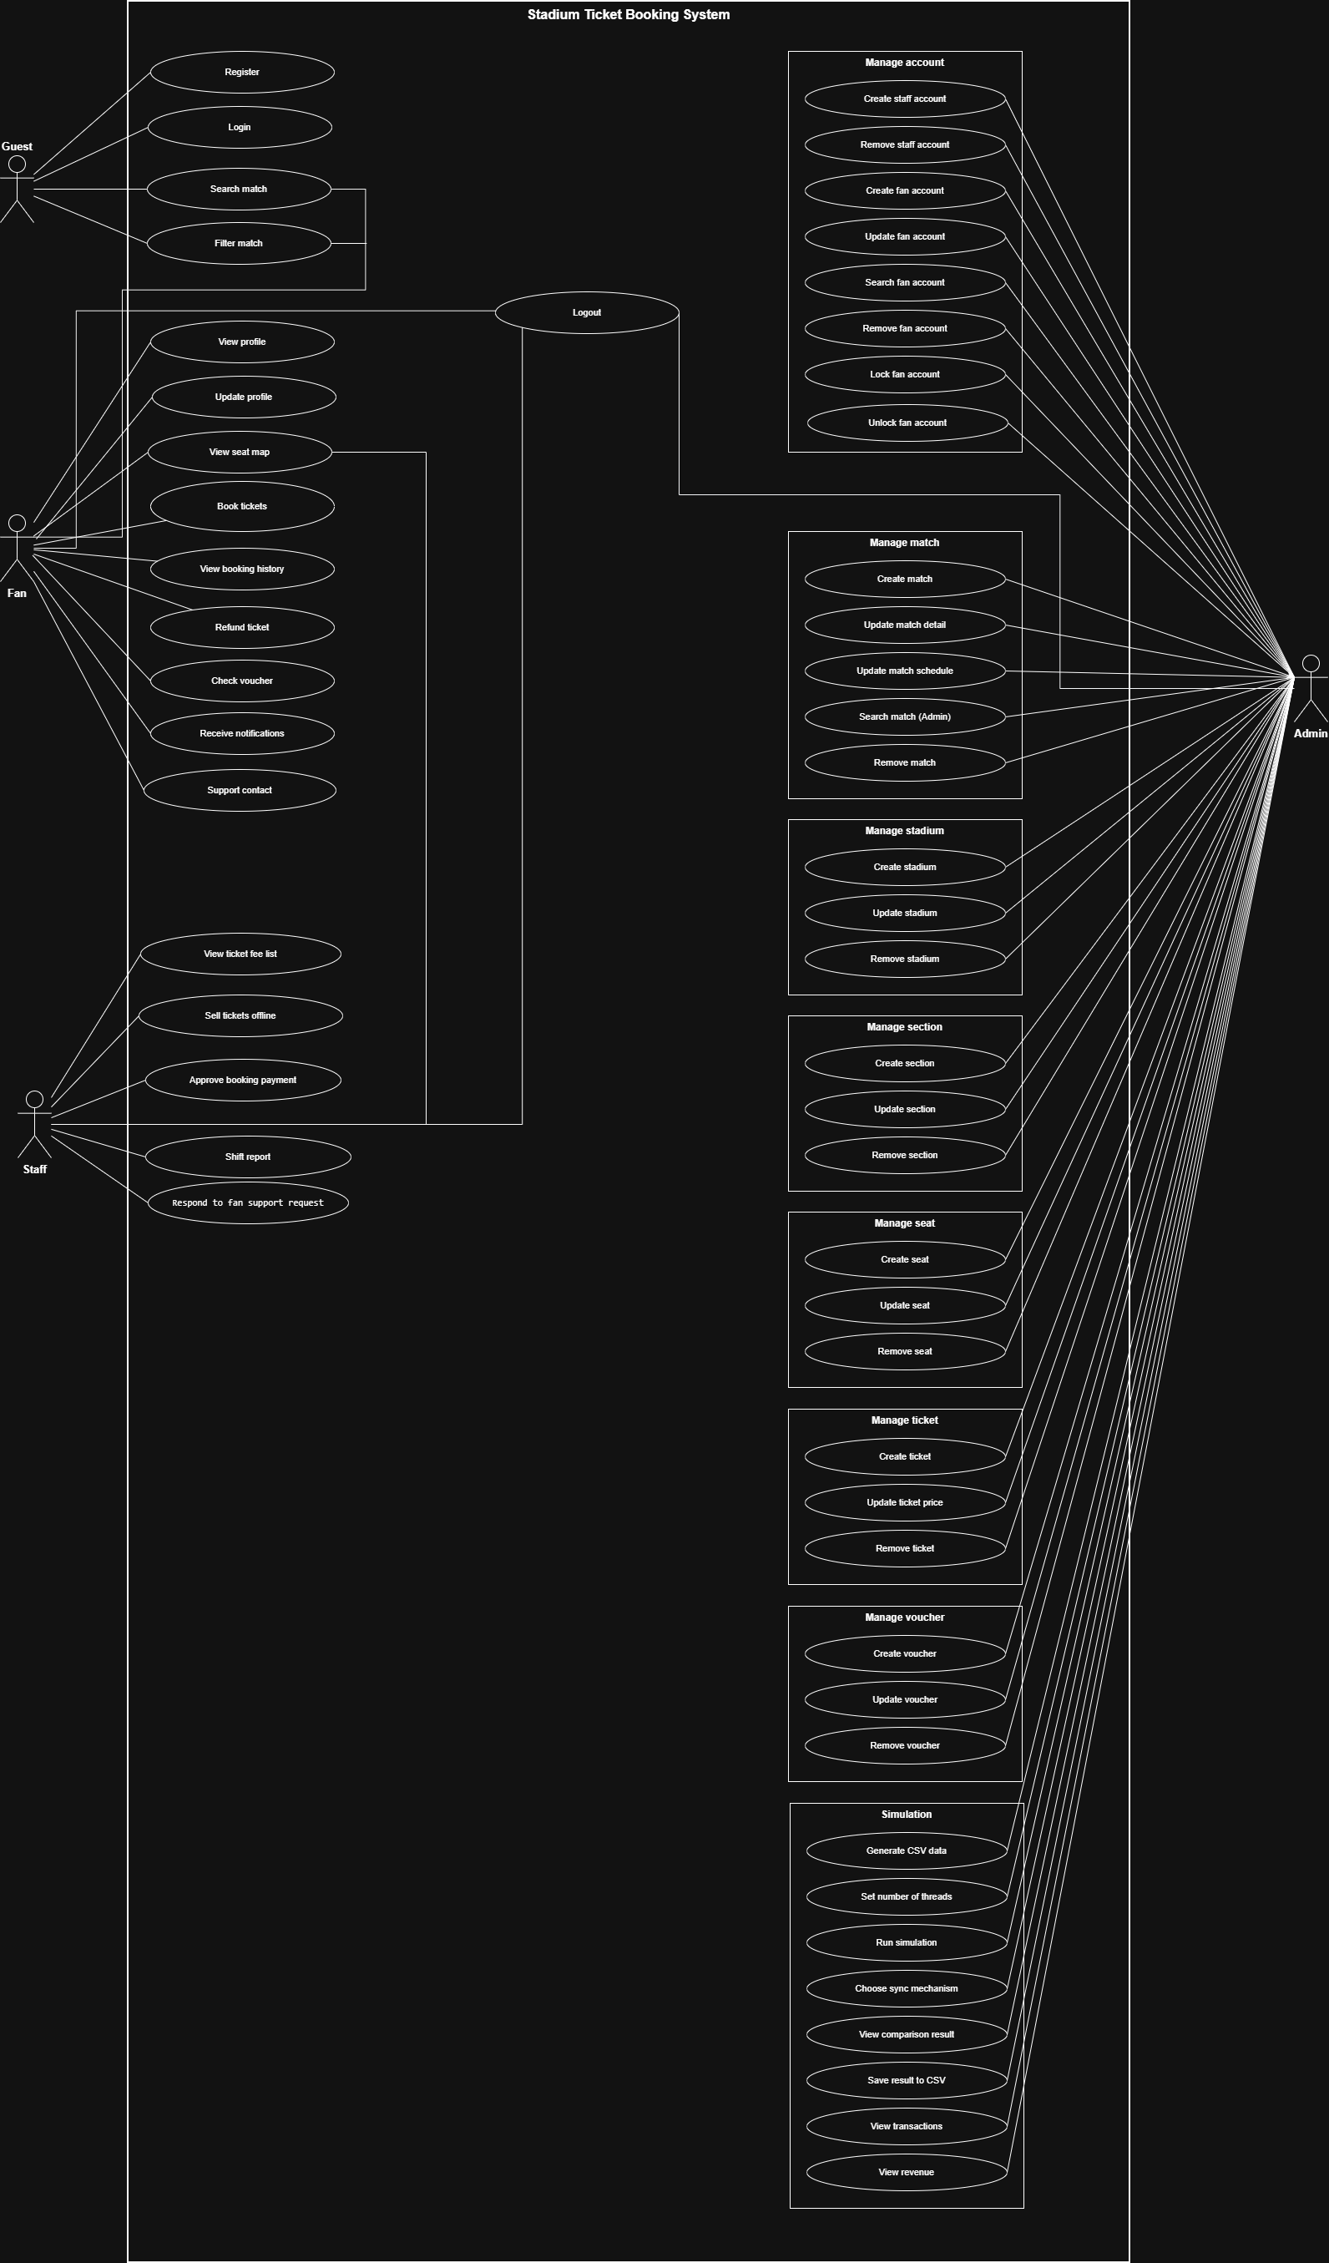
ANALYSIS
Use Case Diagram
Guest · 4 use cases
Register, login, search match, filter match
Fan · 10 use cases
Profile, seat map, book tickets, booking history, refund, voucher, notifications, support
Staff · 7 use cases
Ticket fee list, sell offline, confirm payment and refund, shift report, submit request
Admin · 37 use cases
Eight groups: account, match, stadium, section, seat, ticket, voucher, simulation and data

Slide 4
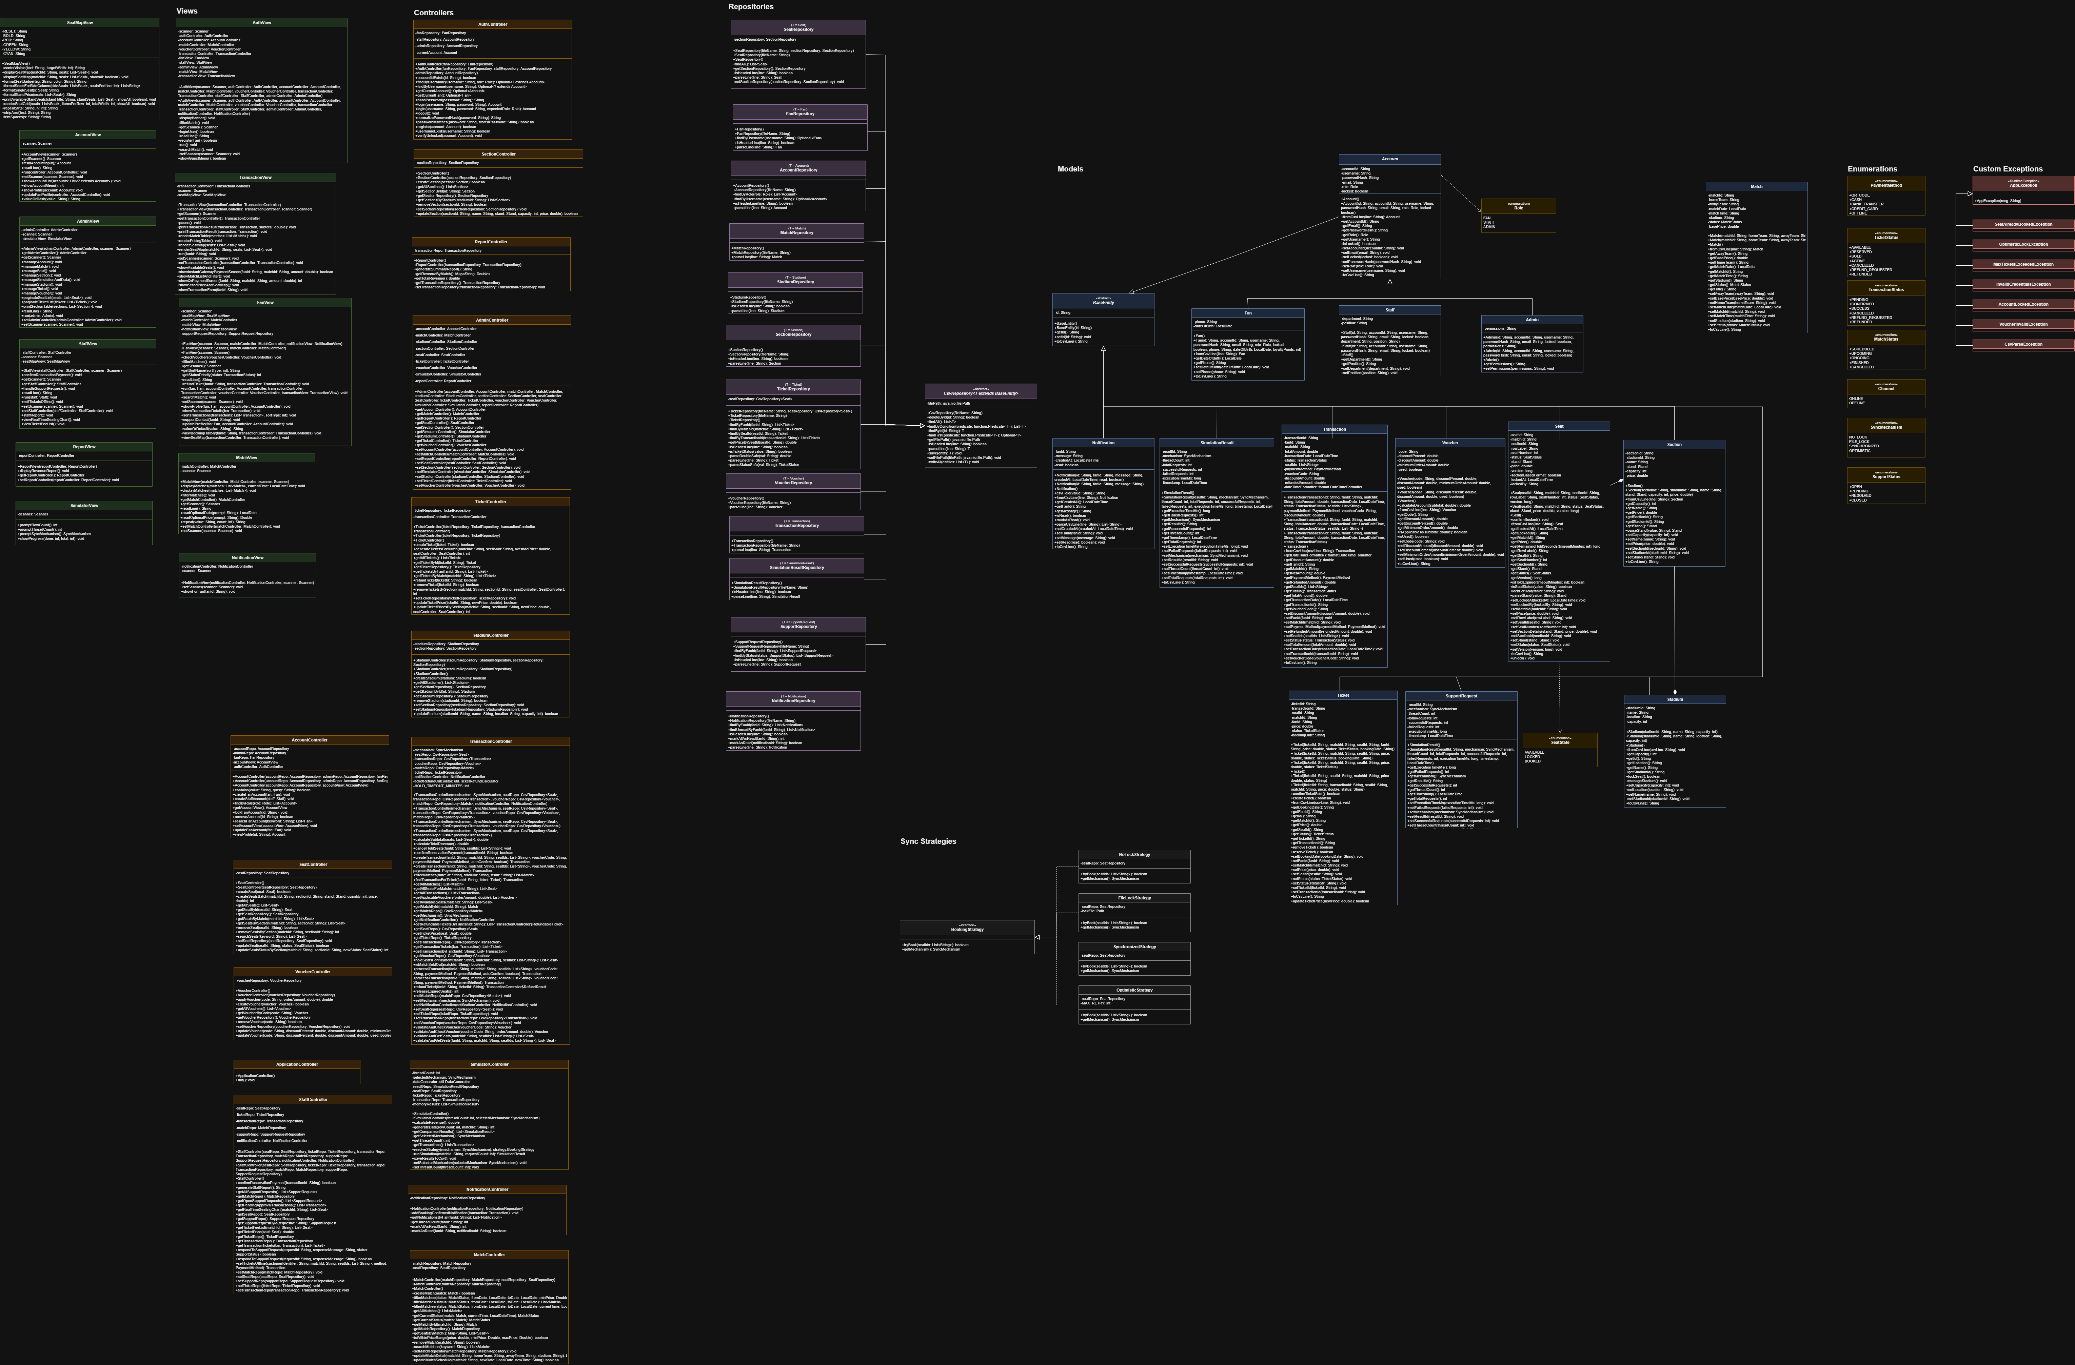
DESIGN
Class Diagram
Model Entities extend BaseEntity
Repository Generic CsvRepository<T> over data/*.csv
Controller Business logic and concurrency control
View Console UI with safe input handling
Strategy BookingStrategy with four sync mechanisms

Slide 5
LIVE DEMO · GUEST
Guest: join the system and find a match
1
Register
New Fan account with strict checks: unique username, valid email, phone, password.
2
Login
Separate flows for Fan, Staff and Admin; locked accounts are rejected automatically.
3
Search match
By team name, stadium name or match ID.
4
Filter match
By date, stadium or team; sold-out matches are marked automatically.

Slide 6
LIVE DEMO · FAN
Fan: from seat map to refund
1
Seat map
Four stands; [O] available, [X] booked, [-] locked; live occupancy rate.
2
Book tickets
Choose match, stand and seats; maximum 4 tickets per booking.
3
Voucher and payment
Minimum order check; pay by QR_CODE, CASH or BANK_TRANSFER; CONFIRMED or PENDING.
4
Booking history
Aligned table, five sort modes, totals by status, detail by # or ID.
5
Refund
Allowed at least 12 hours before kickoff; seats return to AVAILABLE.
6
Notifications
Booking, refund and schedule messages; support requests with status tracking.
Demo account: fan01 · demo123

Slide 7
LIVE DEMO · STAFF
Staff: serve the counter and approve requests
1
Sell offline
Enter customer, pick free seats, take cash or card, issue tickets at once.
2
Confirm payment
List PENDING transactions; confirm by ID, by #, or type "all".
3
Approve refund
Confirm valid refund requests and release the seats.
4
Seating chart
Real-time fill status of every stand.
5
Invoice
Printed on screen and saved to data/invoices/.
6
Shift report
Tickets sold, shift revenue, refunded amount, staff on duty.
Demo account: staff01 · demo123

Slide 8
LIVE DEMO · ADMIN
Admin: manage everything and test concurrency
Sync mechanism | Behavior
NO_LOCK | No sync; exposes race conditions and double sales
FILE_LOCK | File-level synchronization
OPTIMISTIC | Optimistic control with data versions
SYNCHRONIZED | Java monitor lock / ReentrantLock
Also in the demo
Generate 10,000+ seat and ticket rows; set thread count and booking attempts.
A new stadium gets 4 stands automatically (500,000 / 300,000 / 150,000 / 80,000 VND).
Batch create, update and remove seats and tickets by section.
Compare execution time, successful and failed transactions, seat conflicts; export to CSV.
Demo account: admin01 · demo123

Slide 9
CONCLUSION
Thank you. Questions?
Complete
Four roles with role-based login, from search to refund and shift reports.
Safe
Four sync mechanisms compared on time, failures and seat conflicts.
Structured
MVC with a generic CSV repository and Strategy pattern.
Group 5 · LAB211 · Stadium Ticket Booking Simulation System

